Slide 1

SkillSphere Nexus
Integrated Employee Skill, Learning, Certification & Career Management Platform
Team Members · Shailesh, Gowtham, Rohan, Kodur Prashanth
Guide: Vijay Vasanth Sir

Slide 2

INTRODUCTION
What Is SkillSphere Nexus?
A centralized platform unifying employee skills, learning, certifications, career growth, and internal opportunities — helping employees, HR teams, training managers, and administrators understand, develop, validate, and grow talent.
Understand
Map employee skills and competencies
Develop
Deliver targeted learning and training
Validate
Track certifications and credentials
Grow
Support career planning and internal mobility

Slide 3
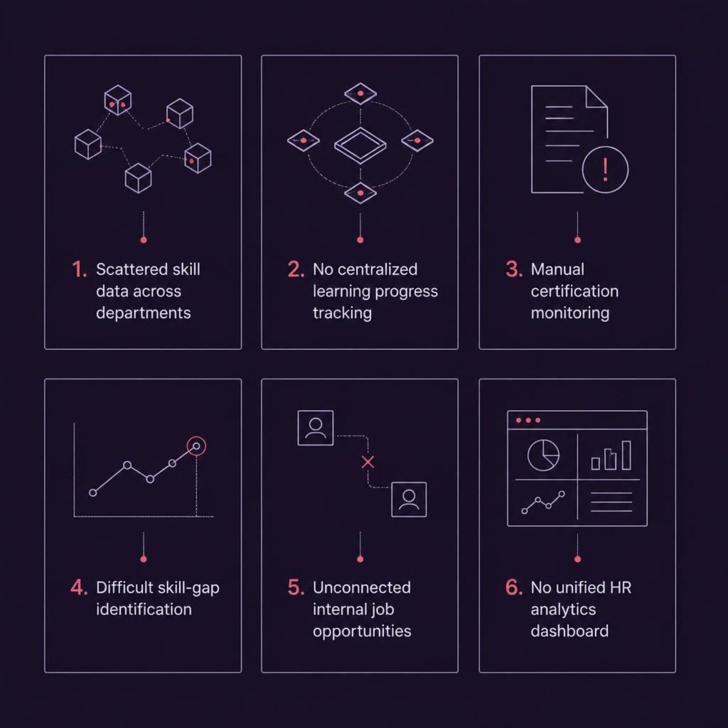
PROBLEM STATEMENT
The Challenge With Traditional Systems
Organizations struggle to connect employee skills with learning, certifications, and career opportunities — creating visibility gaps and inefficient talent development.
Core motivation: HR teams lack a unified system to track, develop,
and grow their workforce effectively.

Slide 4
OBJECTIVES
Project Objectives
Employee Profiles & Skills
Learning Management
Certification Tracking
Manage courses, learning paths, enrollment, progress tracking, and certificate generation.
Register professional certifications, track expiry dates, and manage renewals.
Maintain profiles, skill catalogs, proficiency levels, and competency gap analysis.
Career & Analytics
Secure Access
Support career planning, promotion readiness, internal job matching, and HR dashboards.
Role-based access control via Keycloak for HR, Training Managers, Admins, and Employees.

Slide 5
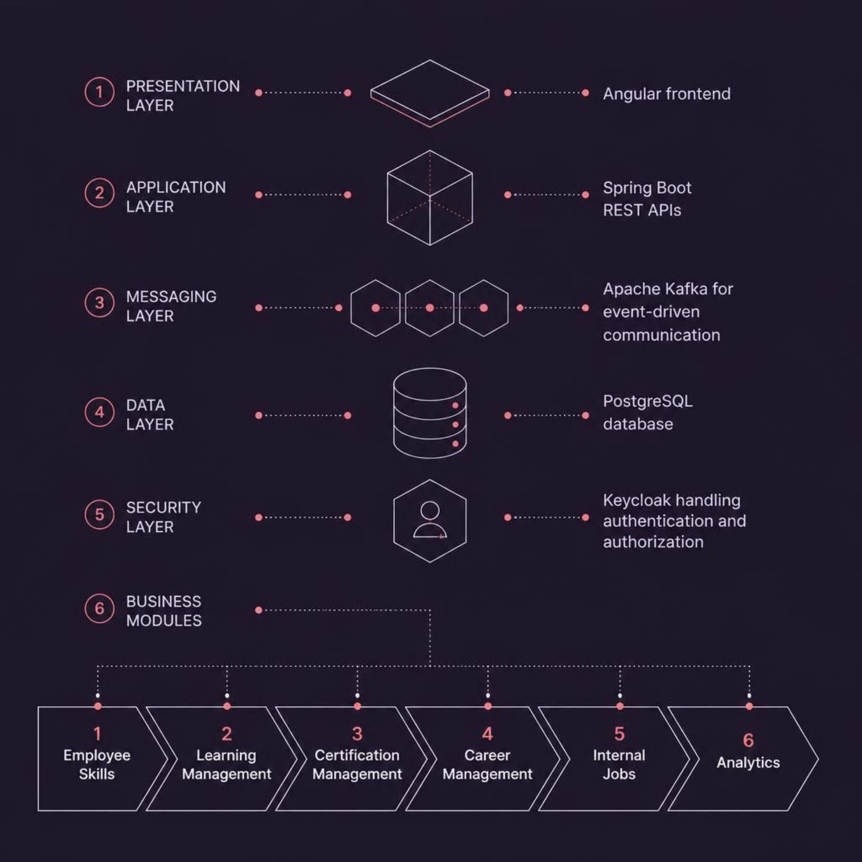
ARCHITECTURE
Technology Stack & System Architecture
Technology Stack
Frontend: Angular — responsive, component-driven UI
Backend: Spring Boot + REST APIs — modular microservices
Database: PostgreSQL — relational data persistence
Auth: Keycloak — OAuth2, and RBAC
Messaging: Apache Kafka — async event-driven communication
The platform follows a modular, integrated architecture — each milestone operates independently while sharing a unified data layer.

Slide 6




ROADMAP
Four-Milestone Project Roadmap
Milestone 1
Milestone 2
Employee Skill Management
Understand the employee — profiles, skill catalogs, and gap analysis
Learning Management
Develop the employee — courses, paths, and certificates
Milestone 3
Milestone 4
Certification Management
Validate the employee — credentials, expiry, and renewals
Career & Analytics
Grow the employee — career plans, internal jobs, and dashboards
Each milestone builds on the previous, forming a fully connected employee development lifecycle.

Slide 7
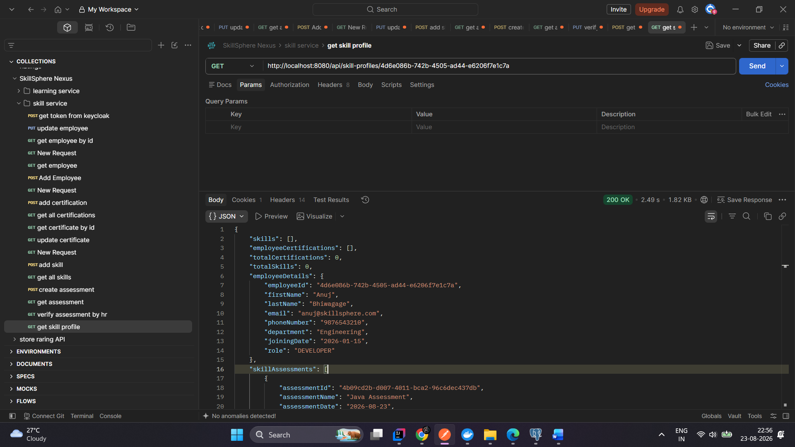
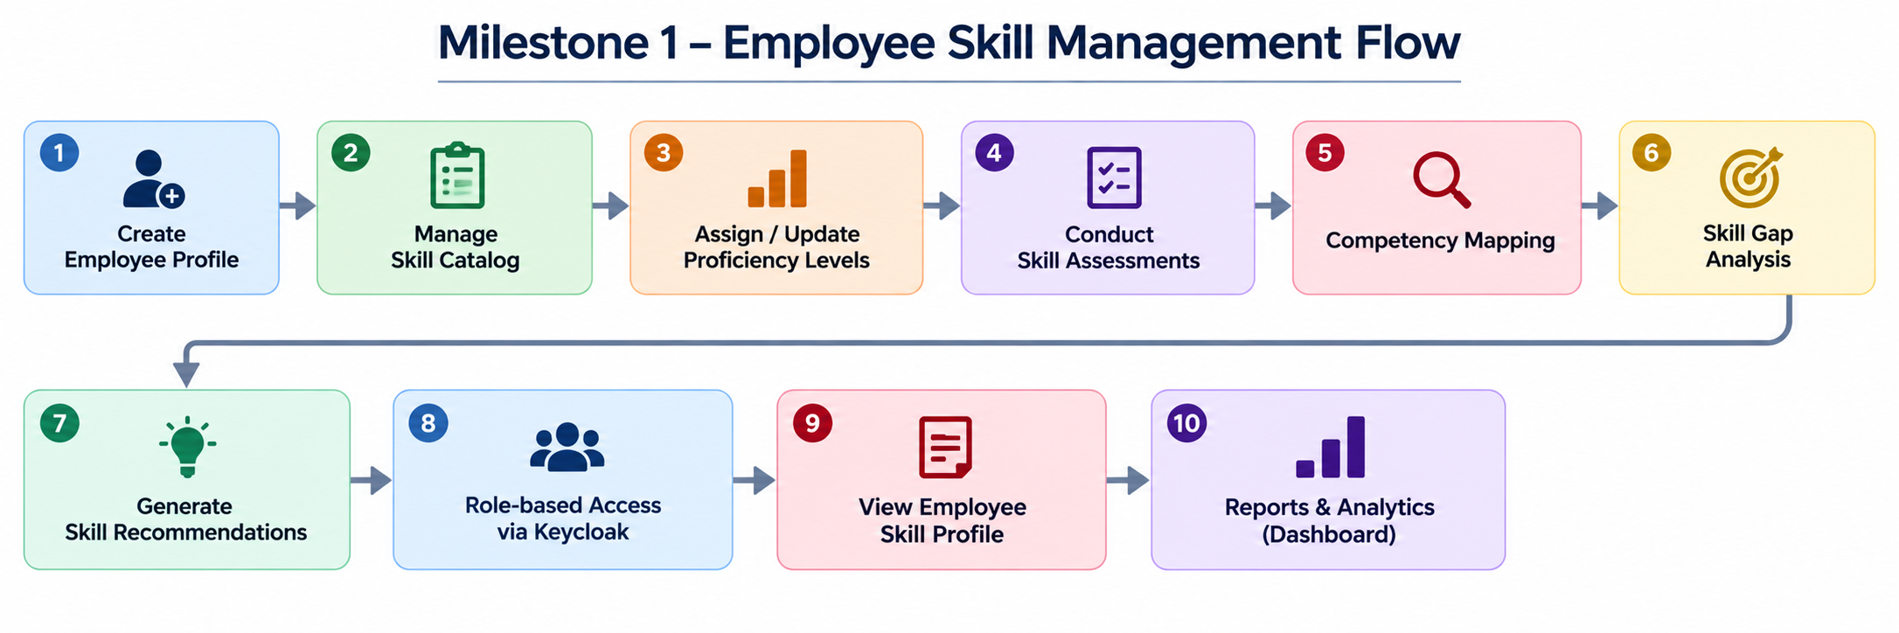
MILESTONE 1
Skill Management
Milestone 1 — Employee Skills
Employee profile & skill catalog management
Proficiency-level tracking and skill assessments
Competency mapping and skill-gap analysis
Role-based access via Keycloak
System compares current proficiency with role requirements to identify gaps.

Slide 8
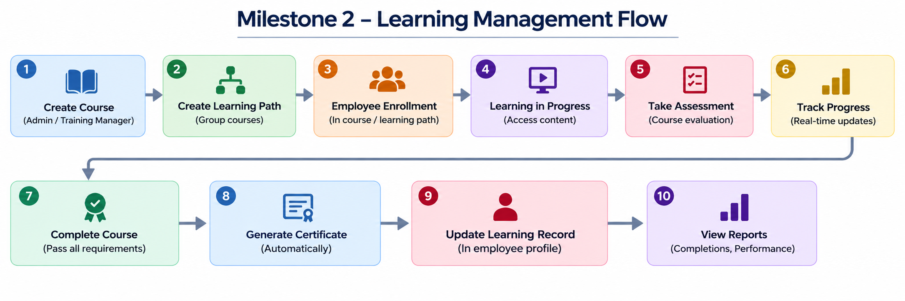
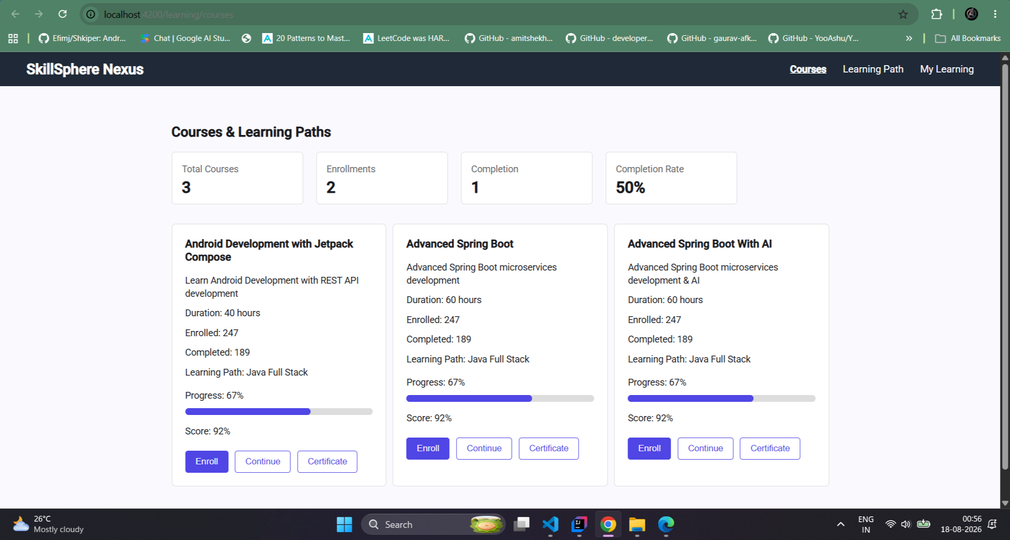
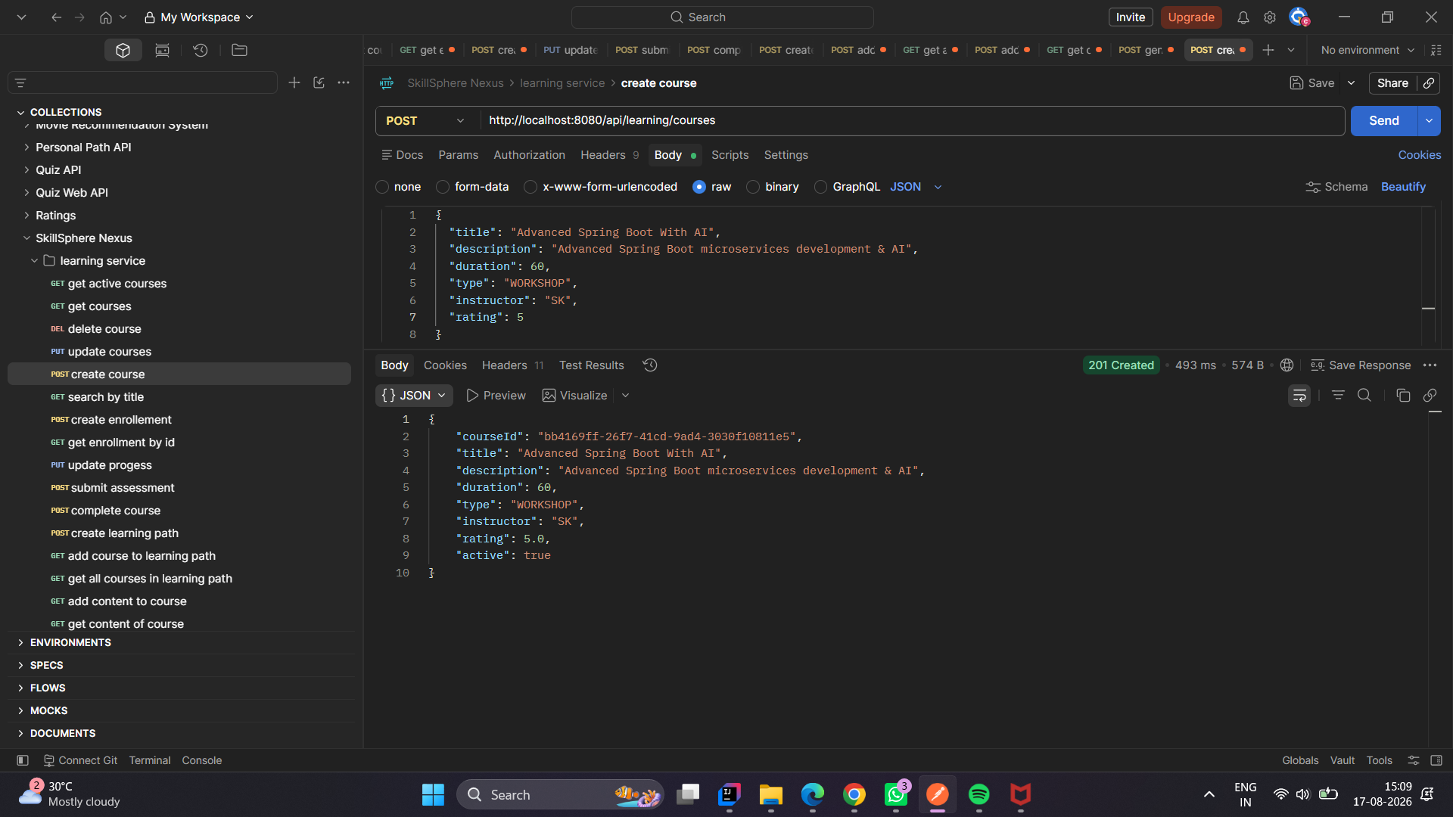
MILESTONES 2
Learning Management
Milestone 2 — Learning Management
Course and learning path creation
Employee enrollment and progress tracking
Assessment recording and course completion
Automated learning certificate generation
Example: Progress 67% → Assessment 92% → Certificate generated

Slide 9
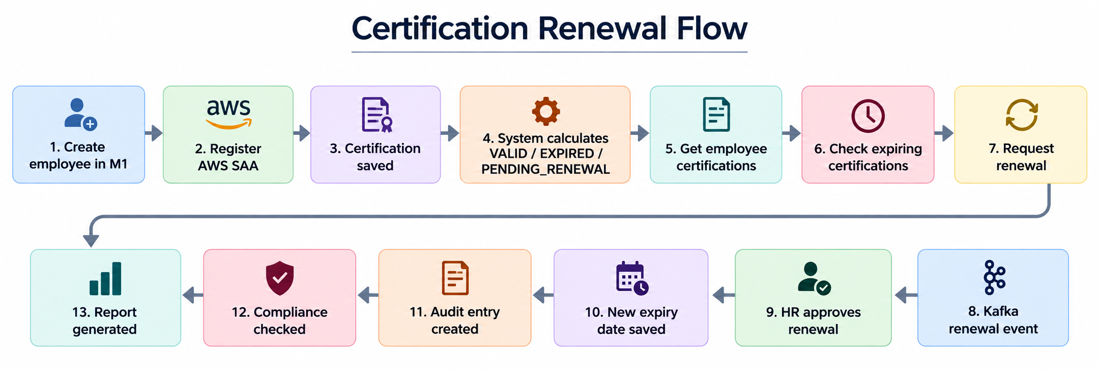
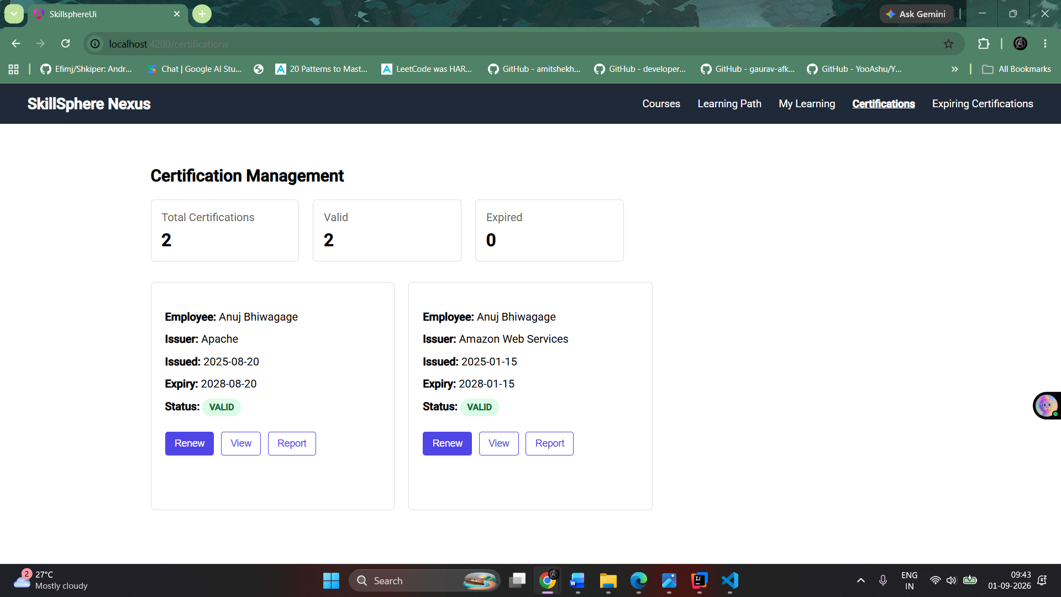
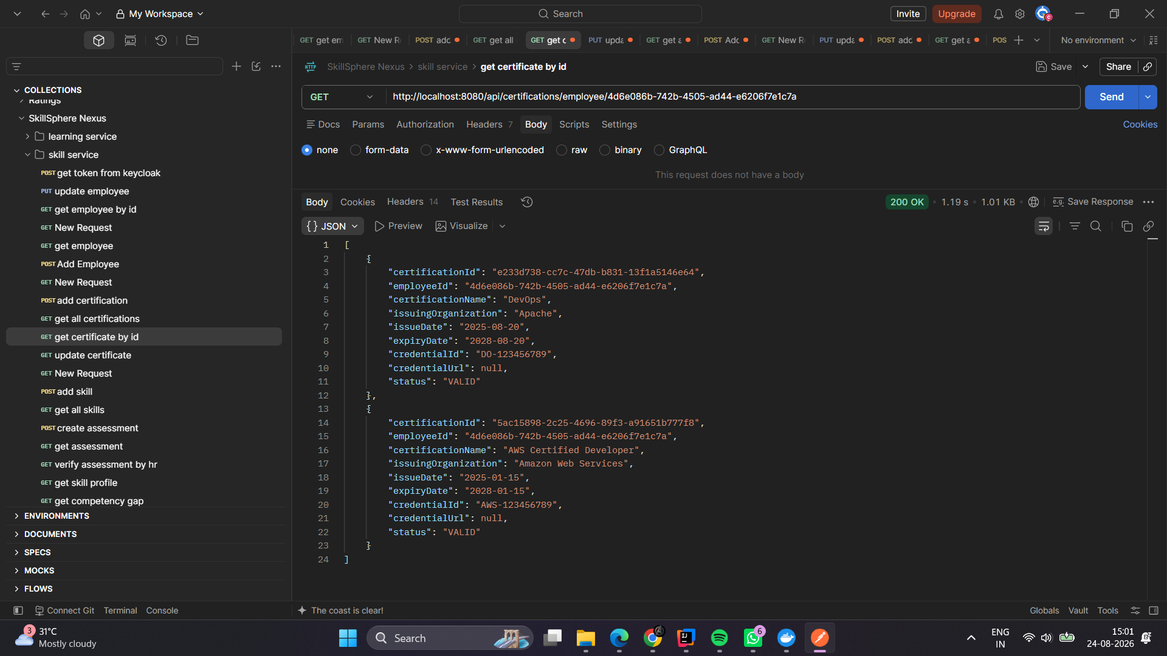
MILESTONES 3
Certification Management
Milestone 3 — Certification Management
Professional certification registration and updates
Status: VALID, EXPIRED, PENDING_RENEWAL
30-day renewal warnings via Kafka notifications
Renewal request and approval workflow
Certification audit trail and compliance API

Slide 10
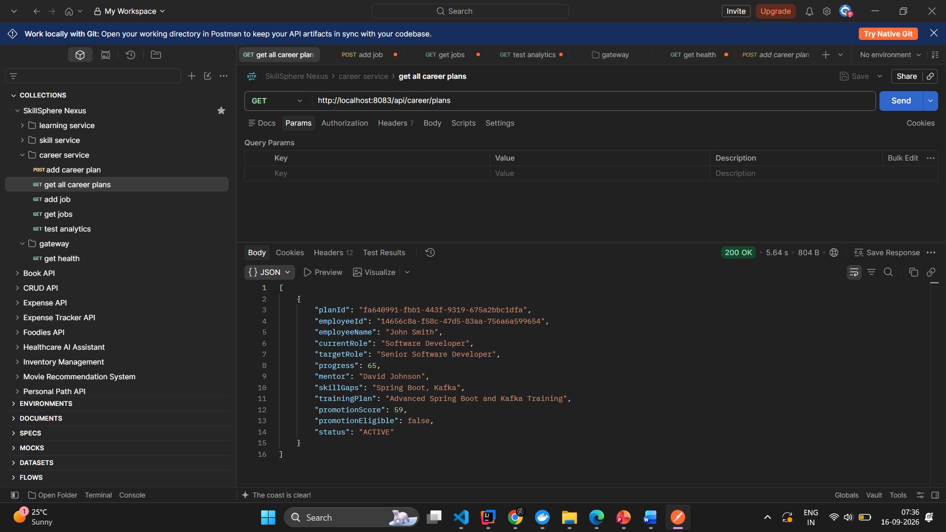
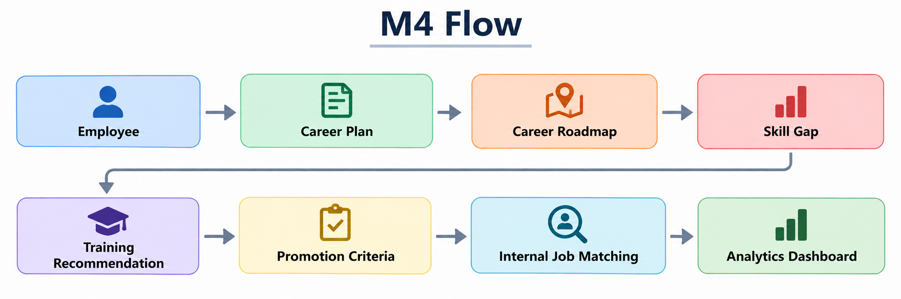
MILESTONES 4
Career Growth
Milestone 4 — Career & Analytics
Career plan creation with current and target roles
Mentor assignment and personalized training plans
Promotion readiness tracking and criteria mapping
Internal job portal with skill-based matching
Executive analytics: career plans, skill coverage, job openings

Slide 11
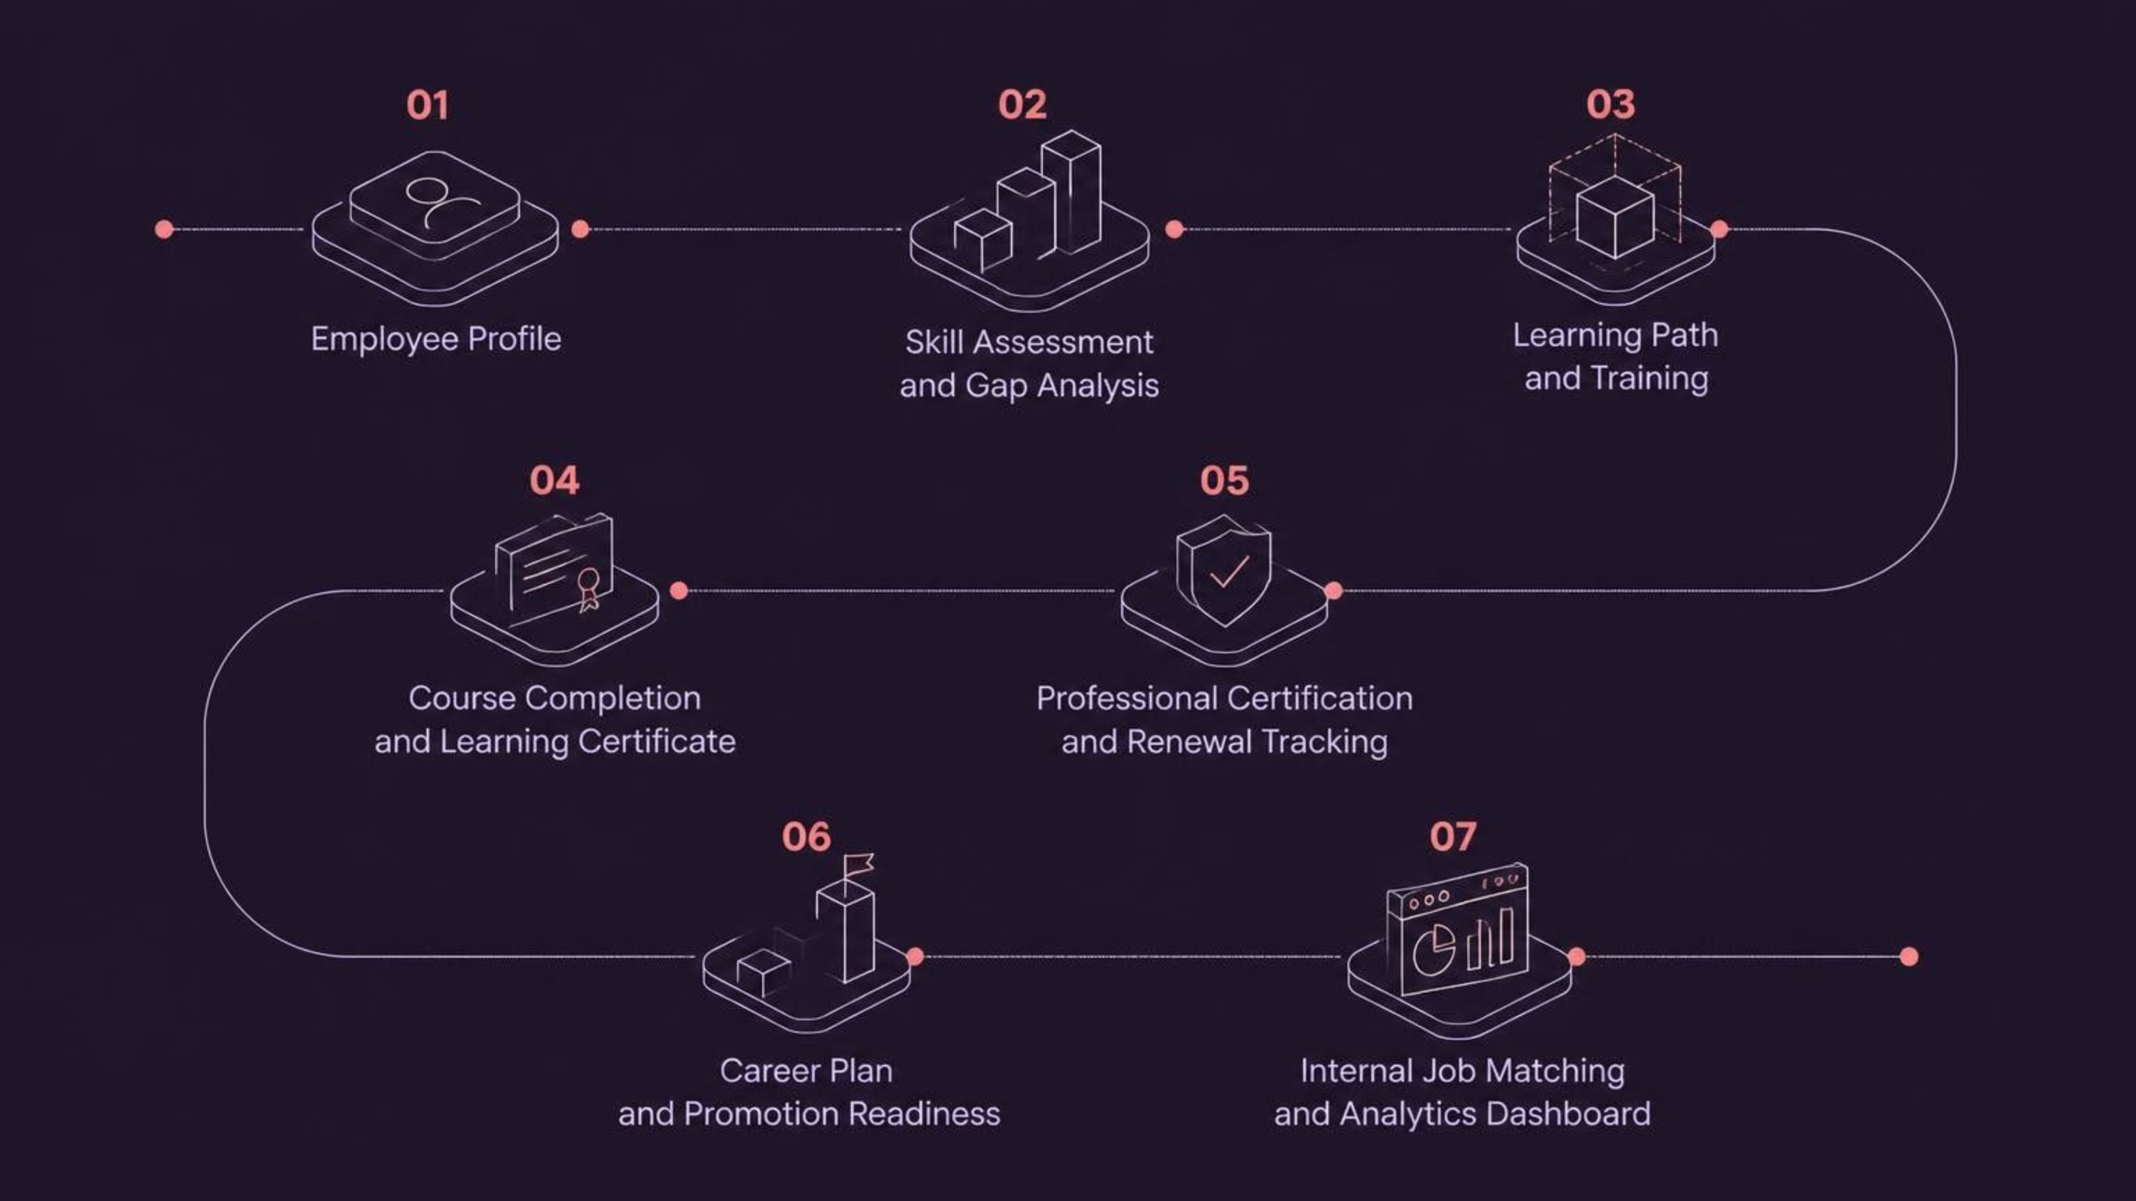
INTEGRATION & DASHBOARD
End-to-End Integration & User Experience
Unified Platform
Dashboard Highlights
All four milestones operate as one connected system. Data flows seamlessly from skill assessment through learning, certification, and career progression — visible through a single centralized dashboard.
Clickable module sections for each domain
Role-based access: HR, Training Manager, Admin, Employee
Clear progress indicators and status badges
Integrated view of skills, learning, certifications, and careers
Easy navigation with consistent UI patterns

Slide 12
SECURITY & FUTURE
Security, Future Enhancements & Conclusion
Security & Validation
Proposed Future Enhancements
Keycloak-based authentication with OAuth2 and SSO
Role-based access: HR, Training Manager, Admin, Employee
REST API validation across all modules
Secure, validated access to analytics dashboard
AI-based Skill and Course Recommendations: Suggest personalized learning paths based on employee skills and career goals.Intelligent
Intelligent Employee-Job Matching: Match employees with suitable internal job opportunities based on their skills and experience.
Gamification & Rewards: Award EXP points for completing courses and certifications, which users can redeem for rewards and incentives.

Slide 13
Conclusion
SkillSphere Nexus unifies employee development — from skills and learning to certifications and growth — improving visibility, planning, and progression across the career organization.
Thank You

